Slide 1
Quiz (T/F):
Software Engineering is not Engineering,
since SE = implementation
Software Engineering is not Science,
since SE has no philosophy.
Question:
Are you a scientist or an engineer?

Slide 2
What’s an architecture like?
…an answer can help us answer
what’s a software architecture like?

Slide 3
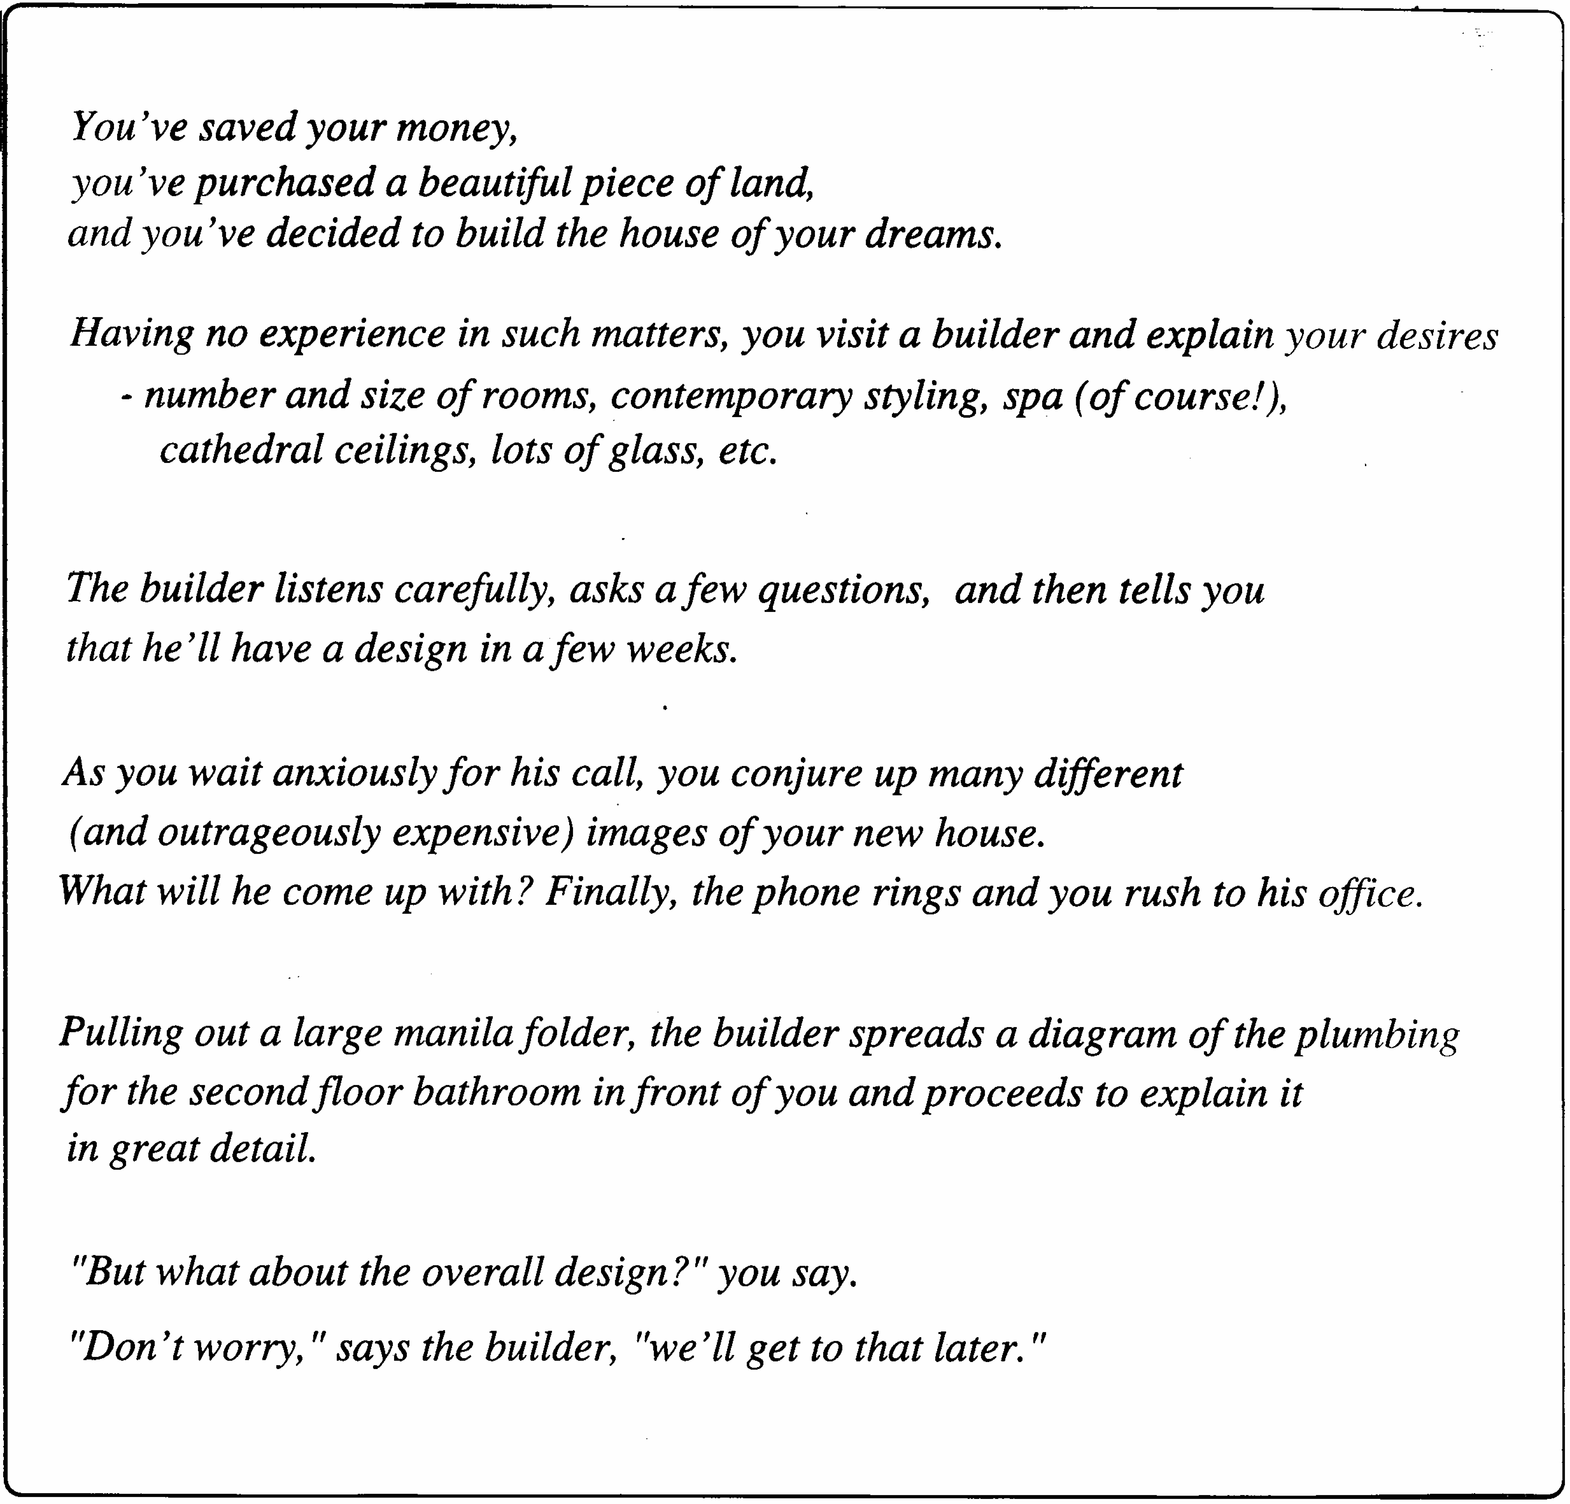

Slide 4
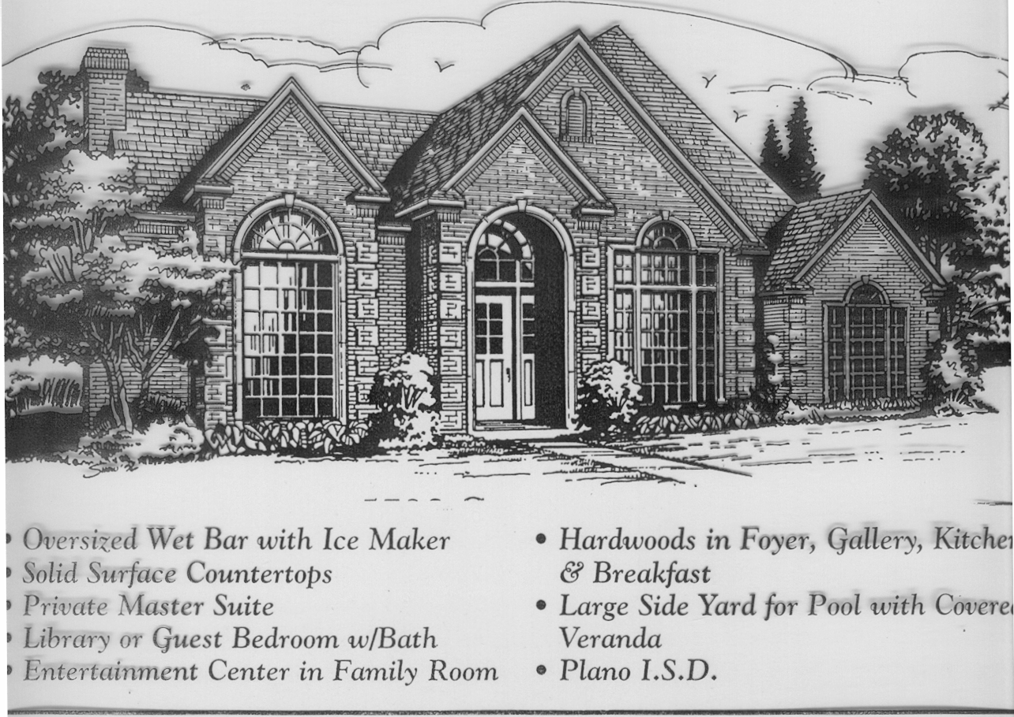
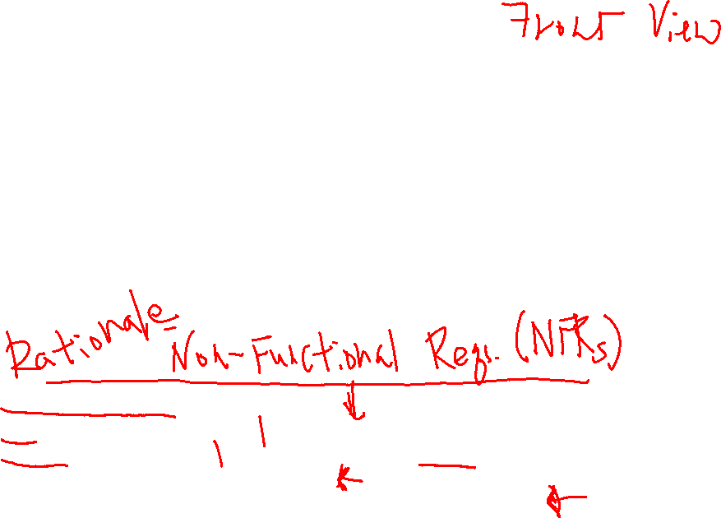

Slide 5
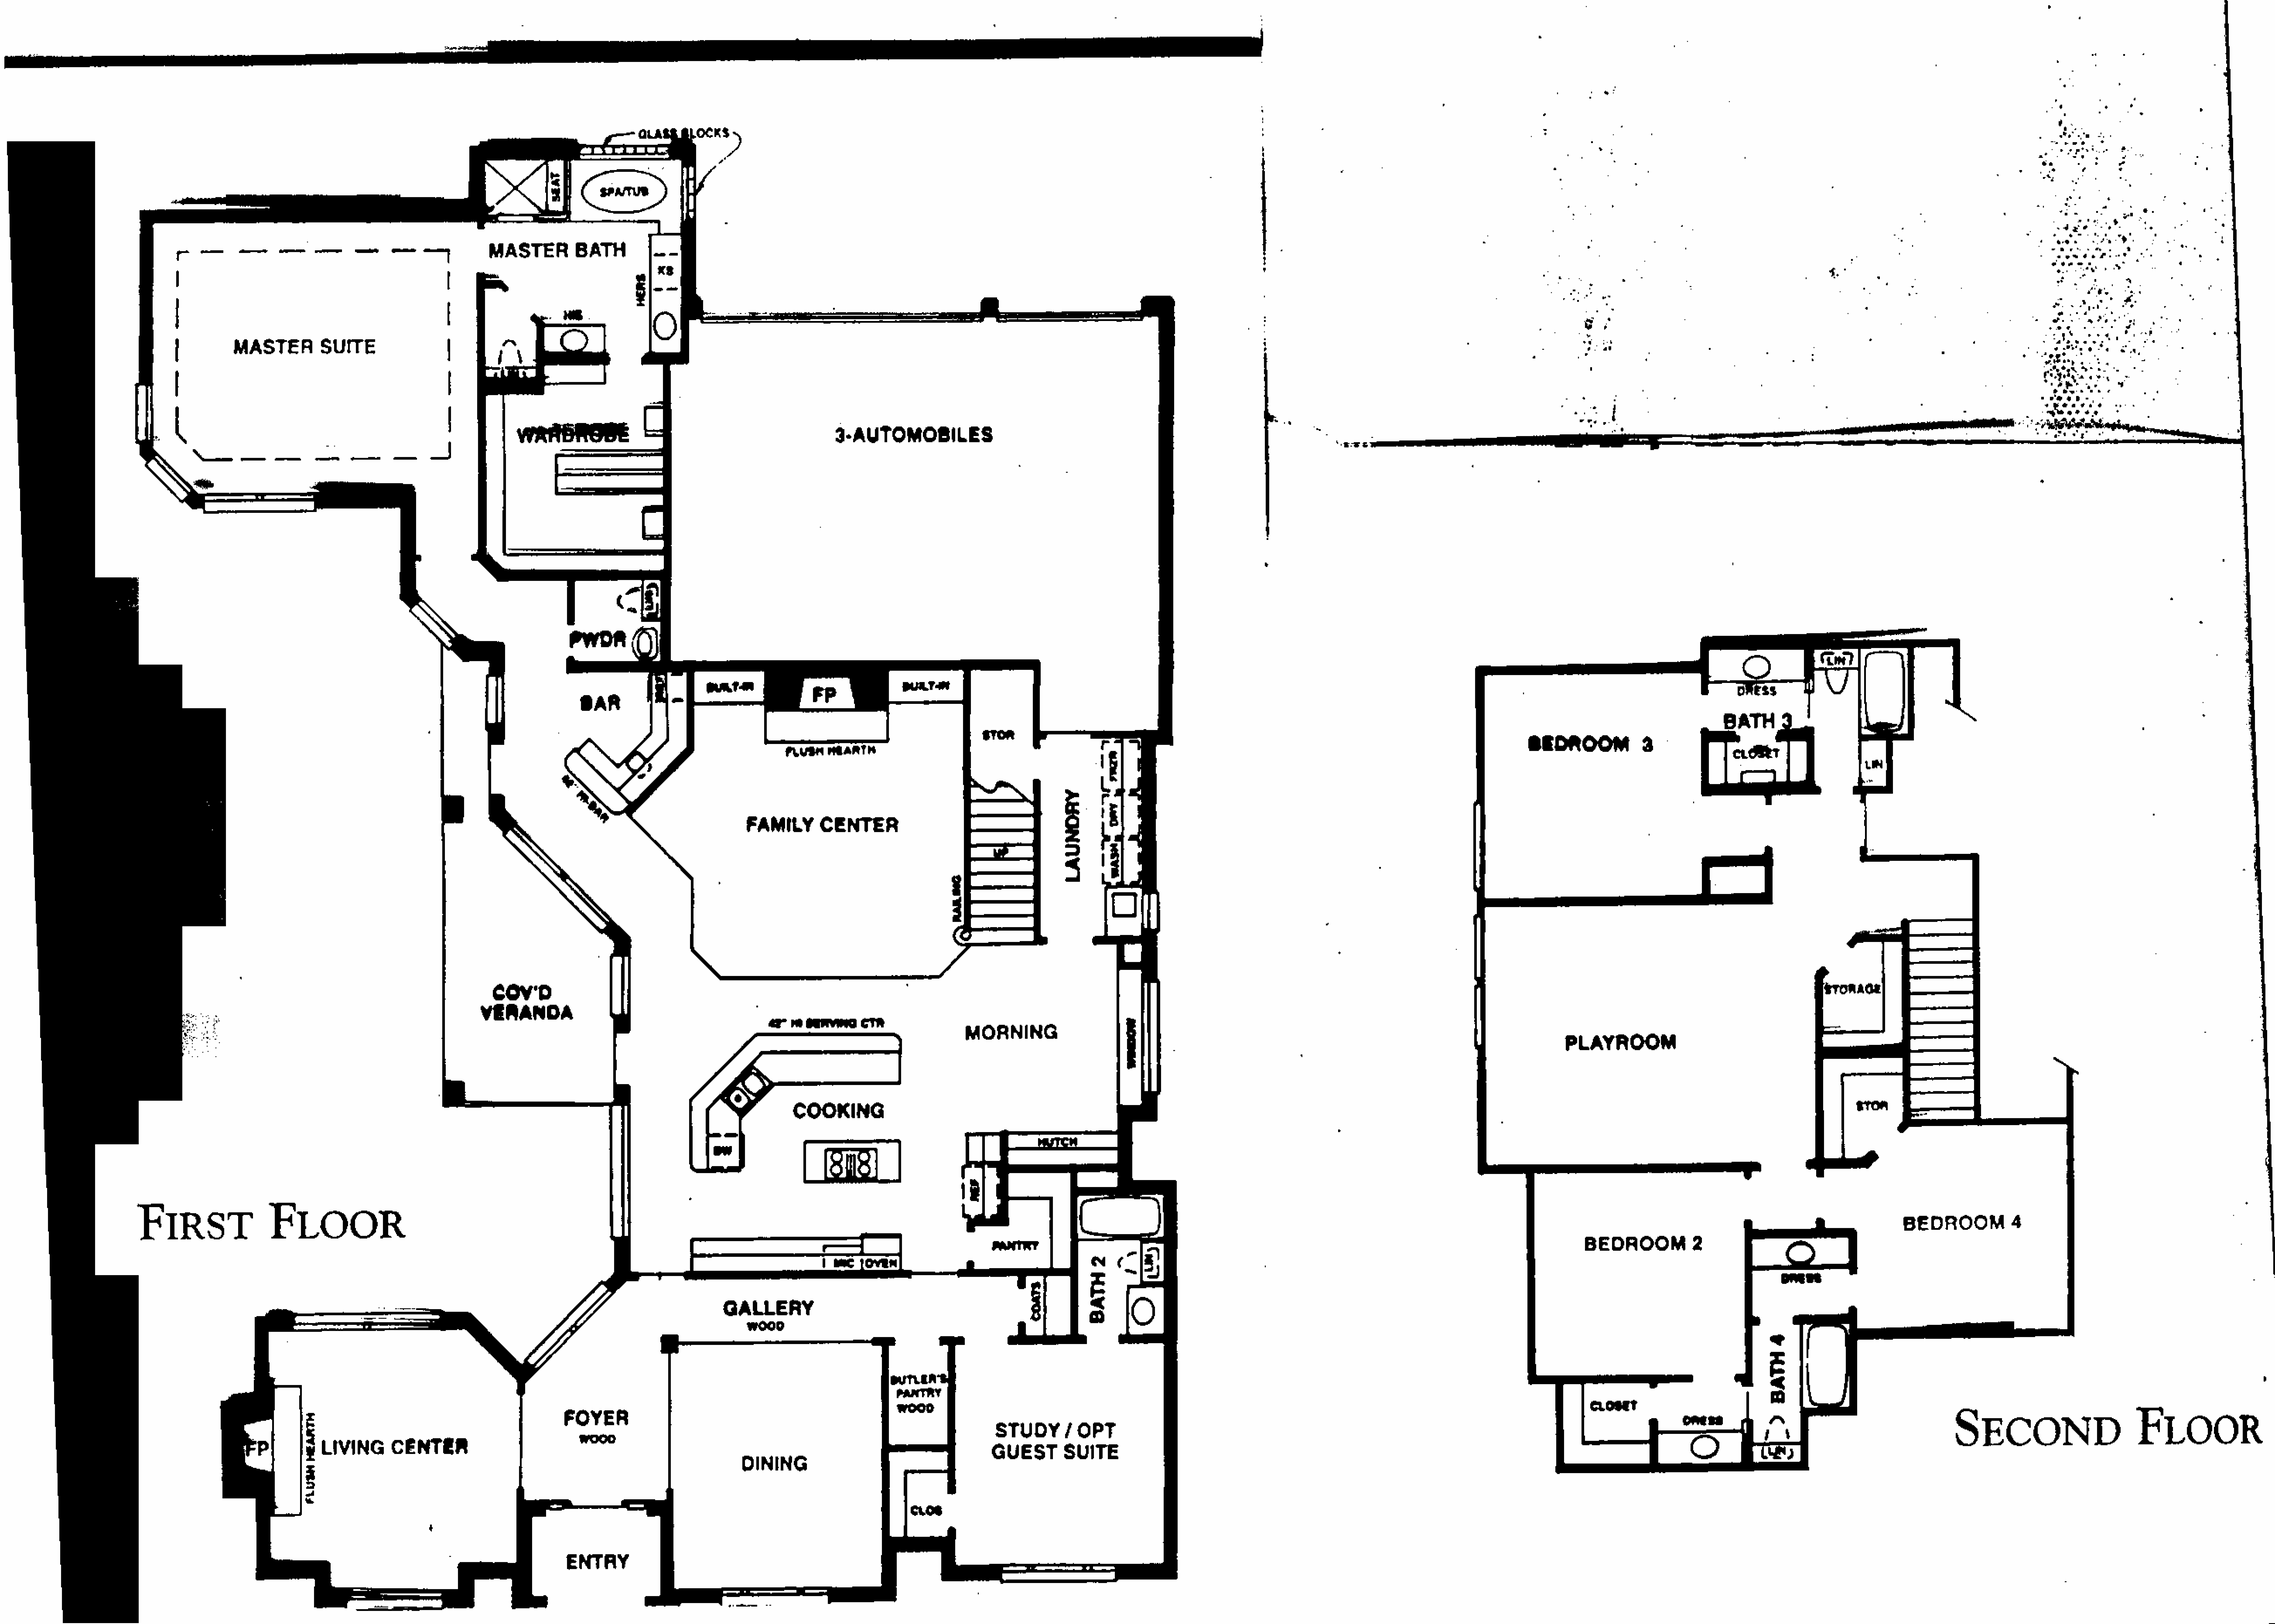
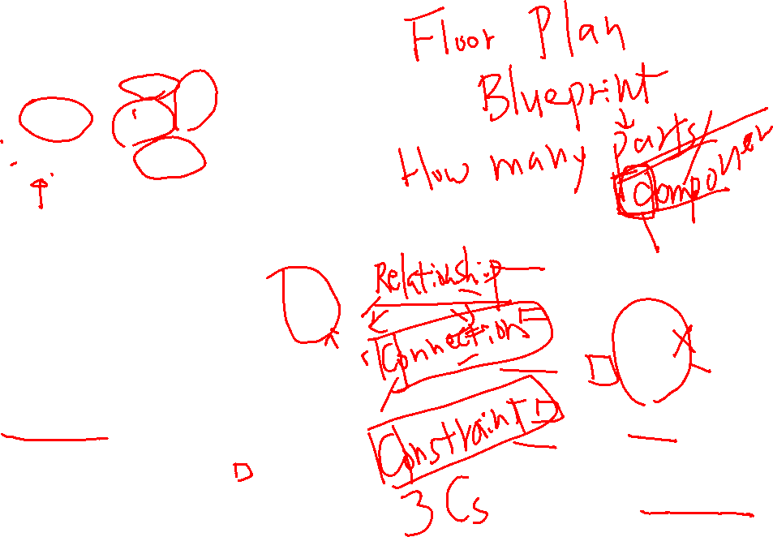

Slide 6
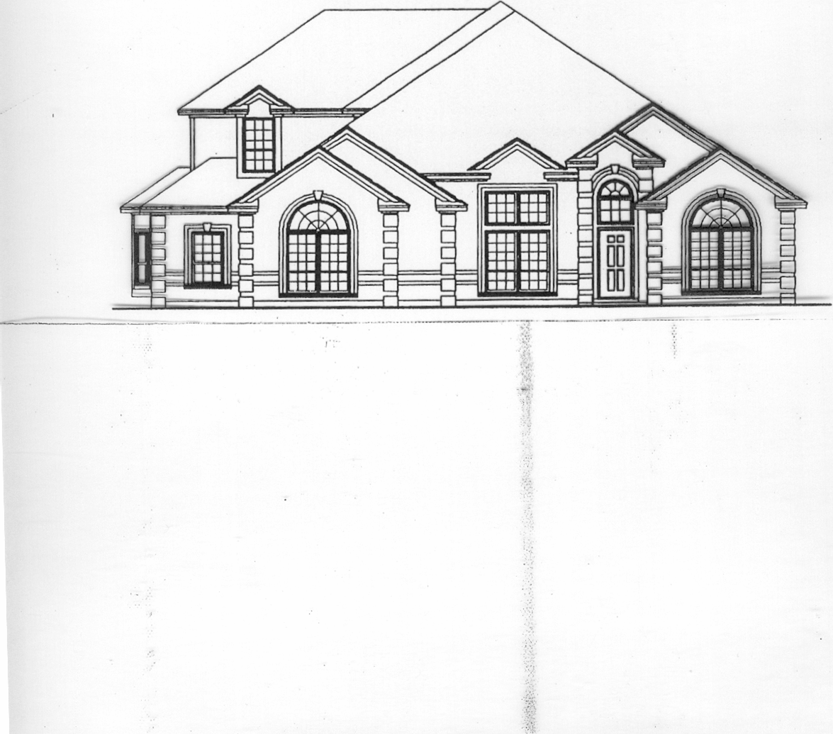


Slide 7
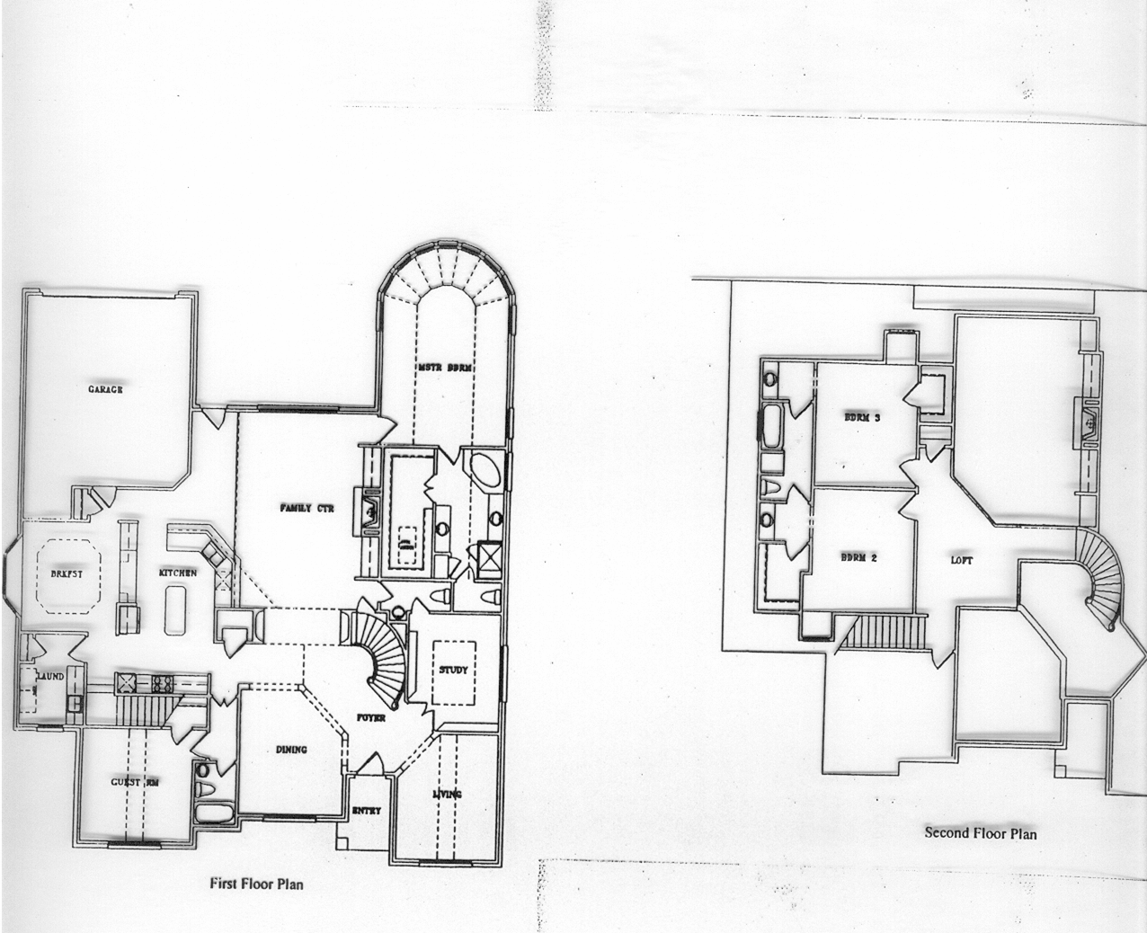
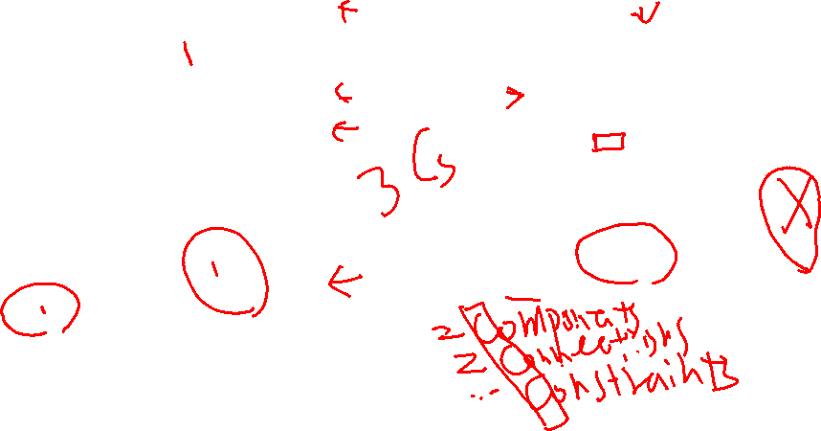

Slide 8
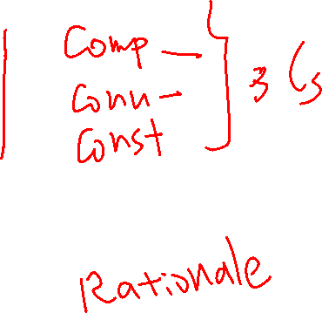
So, what do you see in an architecture?
1.
2.
3.
4.
5.
…
…an answer can help us answer
what’s a software architecture like?

Slide 9
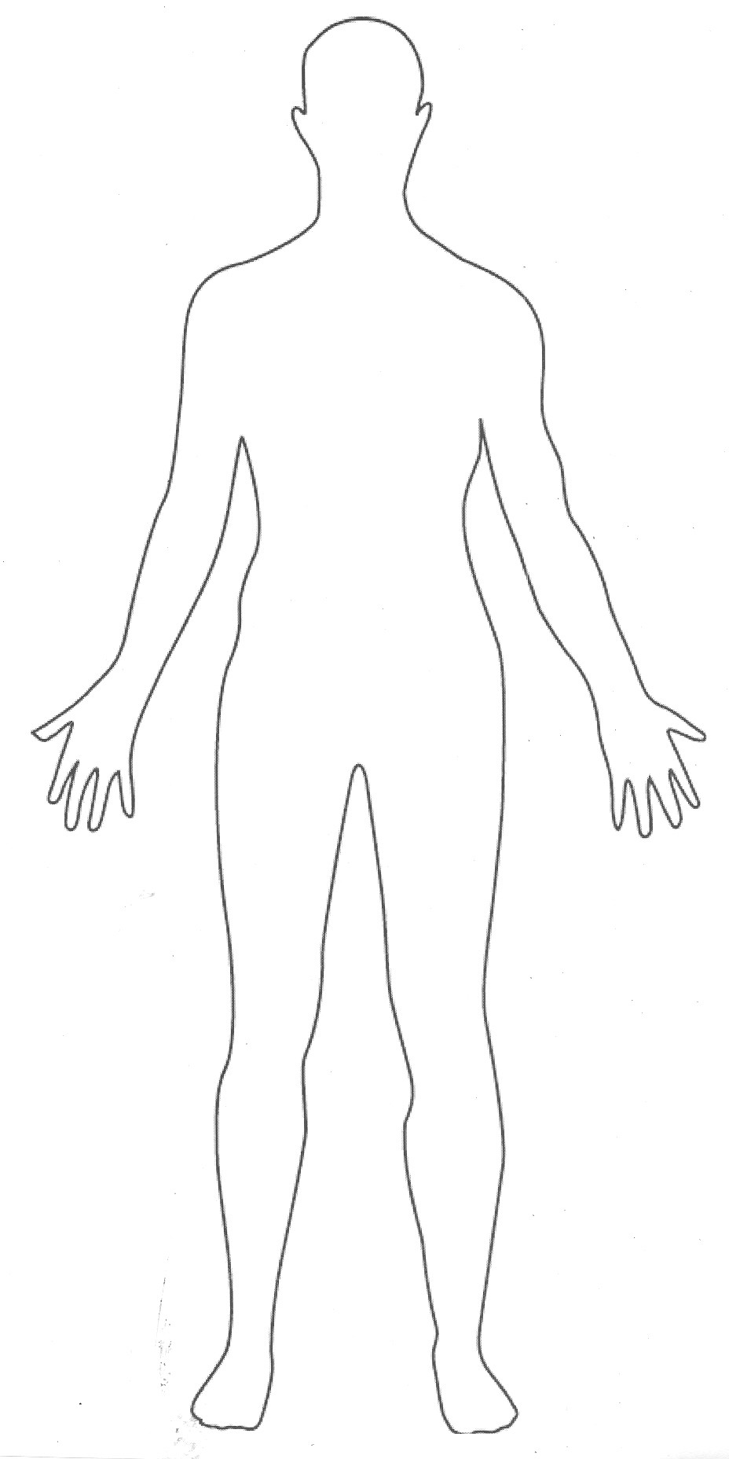

Do you have an architecture?
http://www.google.com/imgres?imgurl=http://arthritisfoundationwpa.files.wordpress.com/2009/07/human_body.jpg&imgrefurl=http://lowdercreative.com/images/view.php%3Fq%3Dhuman%2Bbody%2Bparts&usg=__Iezu6KNyyjl4rIeSRvOQtbeYCIY=&h=1856&w=928&sz=89&hl=en&start=0&zoom=1&tbnid=FTjgkQmZjw9yPM:&tbnh=172&tbnw=86&prev=/images%3Fq%3Dhuman%2Bbody%26hl%3Den%26biw%3D1072%26bih%3D792%26gbv%3D2%26tbs%3Disch:1&itbs=1&iact=rc&dur=78&ei=LKUsTcr9D83JcaSEsN4H&oei=BKUsTfHsA4P58AaKto2vCg&esq=10&page=1&ndsp=18&ved=1t:429,r:12,s:0&tx=45&ty=83

Slide 10
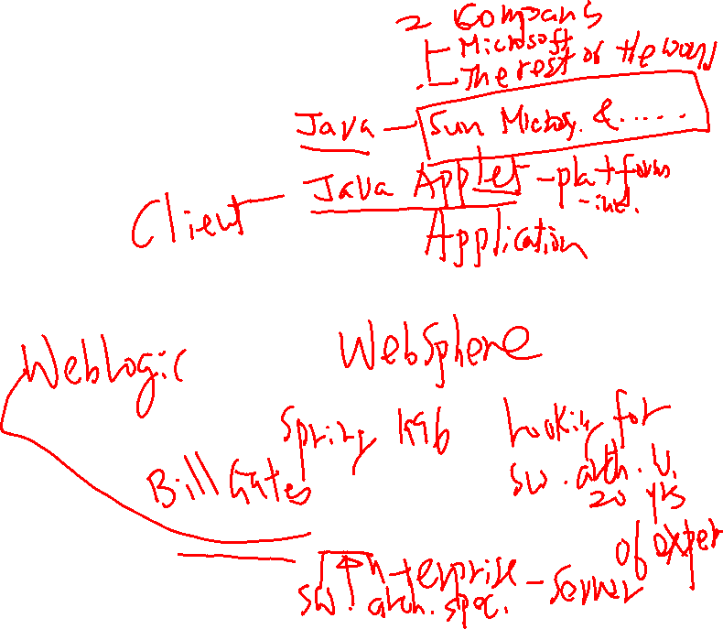
A Brief History
1969: the term “software engineering” was coined
Mid 70’s:
  Requirements definition recognized as a key problem area
  The notion of “modules” starts to appear
  – Work by Parnas,
  - Module Interconnection Languages
1995:
  1st International Workshop on Software Architecture
  Book by Shaw & Garlan
early 2000’s:
  chief software architects, system architects, DB architects, etc.
  more emphasis in middleware, J2EE/.NET, and components
…but, still emerging, evolving

